Slide 1


Slide 2
ABOUT PLUTUS
PLUTUS is an e-wallet system which allows you to store your credit card and bank account numbers in a secure environment, and eliminate the need to enter in account information when making your payment. Once you have registered and created E-Wallet profiles, you can make payments faster and with less typing.

Slide 3
OVERVIEW
PLUTUS provides you with abstraction for your credit card details so that you don’t have to enter all credit card details all the time. Plutus has the following features :
Paper free money transaction.
Send/Pay money to other users.
Send Request for money to your friends.
Accept or reject request.
See all your transaction history at one place.

Slide 4





Technologies Used:
FRONT-END
BACK-END
HTML 5
PHP
CSS 3
MYSQL
JAVASCRIPT

Slide 5
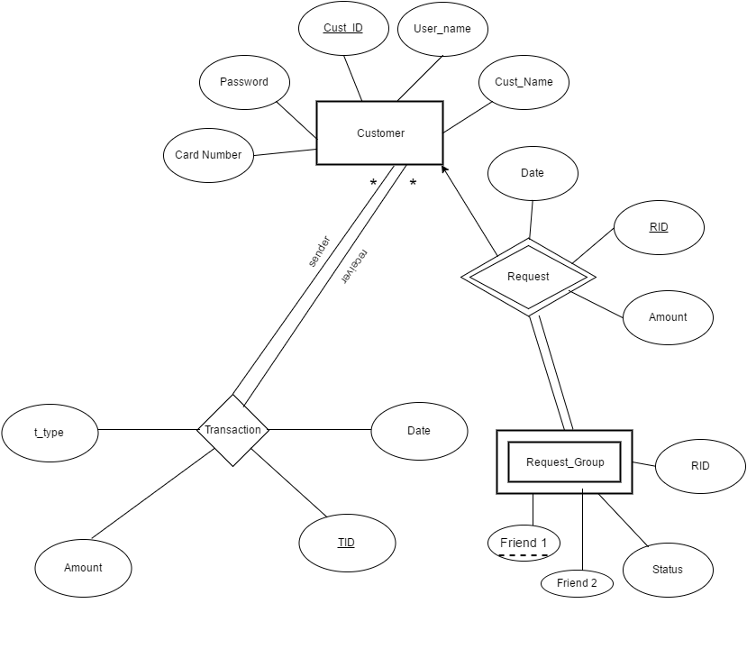
ER-DIAGRAM E-WALLET

Slide 6
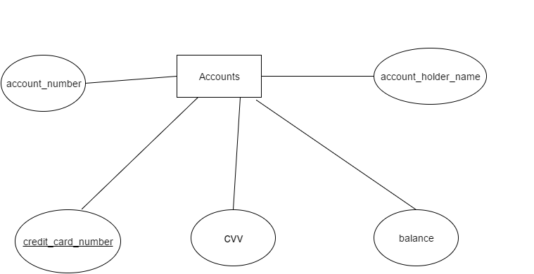
ER-DIAGRAM BANK

Slide 7
DATABASES
BANK
ACCOUNTS
EWALLET
CUSTOMERS
REQUESTS
REQUEST_GROUP
TRANSACTION

Slide 8
NEED OF 2 DIFFERENT DATABASES
We have used a different bank database other than our e-wallet database cause to get account information in real life we would have to connect to a bank database. So we have tried to emulate the same experience here.
Now so as to maintain our projects ACID(Atomicity Concurrency Isolation Durability) properties we have used transactions over distributed databases i.e. (the bank and the e-wallet database) using XA transactions. So that you never face problems with your account when there is a power cut in the midst.

Slide 9
INFORMATION SCHEMA TABLE NAME : ACCOUNTS
# | Name | Type | NULL | Default | Extra
1 | account_number | char(12) | no | none
2 | credit_card_number | char(16) | no | none
3 | account_holder_name | char(20) | no | none
4 | CVV | char(3) | no | none
5 | Balance | float(8,2) | no | 0.00
BANK

Slide 10
TABLE NAME : ACCOUNTS
Account _number | Credit_card_number | Account_holder_name | CVV | Balance
48785124151 | 4495-7540-3281-4101 | Divyesh Soni | 456 | 100545.00
65466646124 | 4595-7880-7291-4201 | Yash Jain | 897 | 78799.00
96248628305 | 4895-7540-8541-4301 | Lakshay Gupta | 485 | 78954.00
35468238795 | 4491-6840-7281-8937 | Anupam Sahu | 571 | 11549.00
BANK

Slide 11
INFORMATION SCHEMA TABLE NAME : CUSTOMERS
# | Name | Type | NULL | Default | Extra
1 | customer_id | int(11) | no | none | AUTO_INCREMENT
2 | customer_name | varchar(20) | no | none
3 | user_name | varchar(20) | no | none
4 | PASSWORD | varchar(36) | no | none
5 | card_number | char(16) | no | none
EWALLET

Slide 12
TABLE NAME : CUSTOMERS
Customer_id (auto_increment) | Customer_name | User_name | PASSWORD (Encrypted as MD5SUM) | Card_number
1 | Divyesh Soni | dsoni001 | 81dc9bdb52d04dc20036 | 4495-7540-3281-4101
2 | Yash Jain | yashu101 | 8cd0fee89585a5d46ed7 | 4595-7880-7291-4201
3 | Utkarsh Sahu | usah231 | 827ccb0eea8a706c4c34 | 4895-7540-8541-4301
4 | Lakshay Jaiswal | laka471 | 239c81f9f49ce3ae4d8d99e | 4491-6840-7281-8937
EWALLET

Slide 13
INFORMATION SCHEMA TABLE NAME : REQUESTS
# | Name | Type | NULL | Default | Extra
1 | rid | int(11) | no | none | AUTO_INCREMENT
2 | customer_id | int(11) | no | none
3 | amount | float(8,2) | no | none
4 | r_date | date | yes | NULL
EWALLET

Slide 14
TABLE NAME : REQUESTS
Rid (autogenerate) | Customer_id | AMOUNT | R_DATE (DD-MM-YYYY)
1 | 2 | 500 | 01-03-2016
2 | 3 | 100 | 20-04-2016
3 | 4 | 487 | 29-04-2016
4 | 8 | 700 | 02-05-2016
EWALLET

Slide 15
INFORMATION SCHEMA TABLE NAME : REQUEST_GROUP
# | Name | Type | NULL | Default | Extra
1 | rid | int(11) | no | None
2 | friend1 | int(11) | no | None
3 | friend2 | int(11) | Yes | NULL
4 | friend3 | int(11) | Yes | NULL
5 | friend4 | int(11) | Yes | NULL
6 | friend5 | int(11) | Yes | NULL
7 | STATUS | int(11) | Yes | NULL
EWALLET

Slide 16
TABLE NAME : REQUEST_GROUP
RID | FRIEND1 | FRIEND2 | FRIEND3 | FRIEND4 | FRIEND5 | STATUS
1 | 2 | 1 | 5 | 7 | 3 | NULL
2 | 5 | 8 | 6 | 1 | NULL | NULL
3 | 7 | 5 | NULL | NULL | NULL | NULL
4 | 8 | NULL | NULL | NULL | NULL | NULL
EWALLET

Slide 17
INFORMATION SCHEMA TABLE NAME : TRANSACTIONS
# | Name | Type | NULL | Default | Extra
1 | tid | int(11) | no | none | AUTO_INCREMENT
2 | amount | float(8,2) | no | none
3 | sender_id | int(11) | no | none
4 | receiver_id | int(11) | no | none
5 | t_date | date | Yes | NULL
6 | transaction_type | char(1) | no | none
EWALLET

Slide 18
TABLE NAME : TRANSACTIONS
TID (auto) | AMOUNT | SENDER_ID | RECEIVER_ID | T_DATE | TRANSACTION_TYPE*
1 | 500 | 1 | 2 | 02-03-2016 | L
2 | 425 | 3 | 7 | 12-04-2016 | S
3 | 1000 | 6 | 10 | 29-04-2016 | S
*L-Loan S-SEND
EWALLET

Slide 19
NORMALISATION
Normalisation is a technique of organizing the data in the database. Normalisation is a systematic approach of decomposing tables to eliminate data redundancy and undesirable characteristics like Insertion, Update and Deletion Anomalies. It is a multi-step process that puts data into tabular form by removing duplicated data from the relation tables.
First Normal Form is defined in the definition of relations (tables) itself. This rule defines that all the attributes in a relation must have atomic domains. The values in an atomic domain are indivisible units.
Second Normal Form states there must not be any partial dependency of any column on primary key. It means that for a table that has concatenated primary key, each column in the table that is not part of the primary key must depend upon the entire concatenated key for its existence. If any column depends only on one part of the concatenated key, then the table fails Second normal form.
Third Normal form applies that every non-prime attribute of table must be dependent on primary key, or we can say that, there should not be the case that a non-prime attribute is determined by another non-prime attribute. So this transitive functional dependency should be removed from the table and also the table must be in Second Normal form.

Slide 20
EWALLET database has been normalized to 3NF
In tables Customers, to ensure 3NF , it has been decomposed so that card details will be fetched from the bank itself.
If we had included other card_details like balance, cvv in the Customers table itself, then it would have violated the 3NF form, since there is non-prime attribute (cvv, balance) which would transitively depend on prime attributes. So, we fetch these details directly from the bank database ,thereby ensuring 3NF form.

Slide 21
SIGNOUT
PAY/GIFT/REQUEST/FULFILL REQUEST
PERFORM TRANSACTION
SIGNUP
LOGIN
Traversing Through Website

Slide 22

HOME

Slide 23
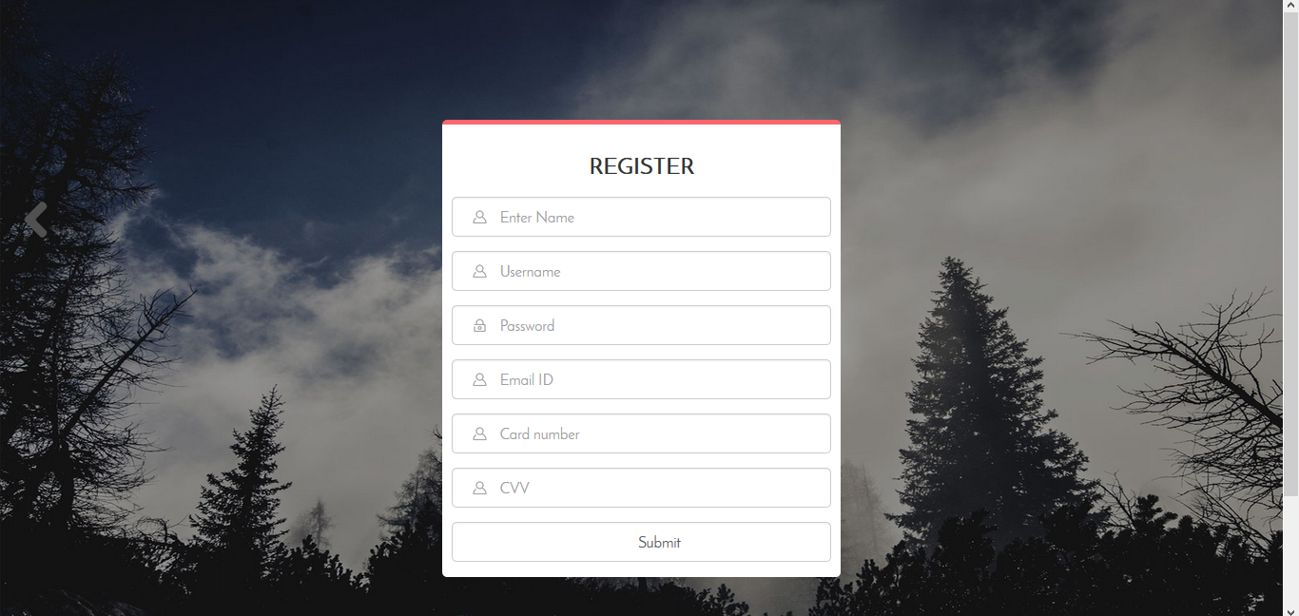
SIGNUP

Slide 24
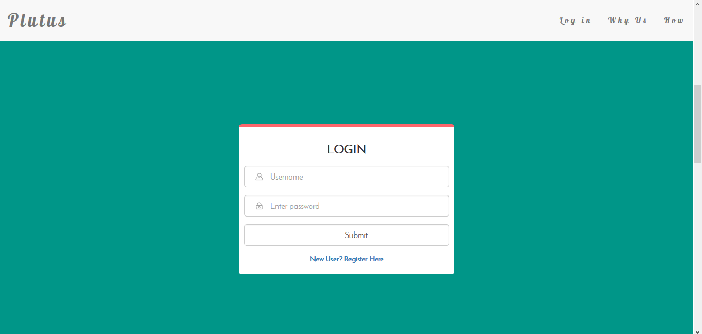
LOGIN

Slide 25
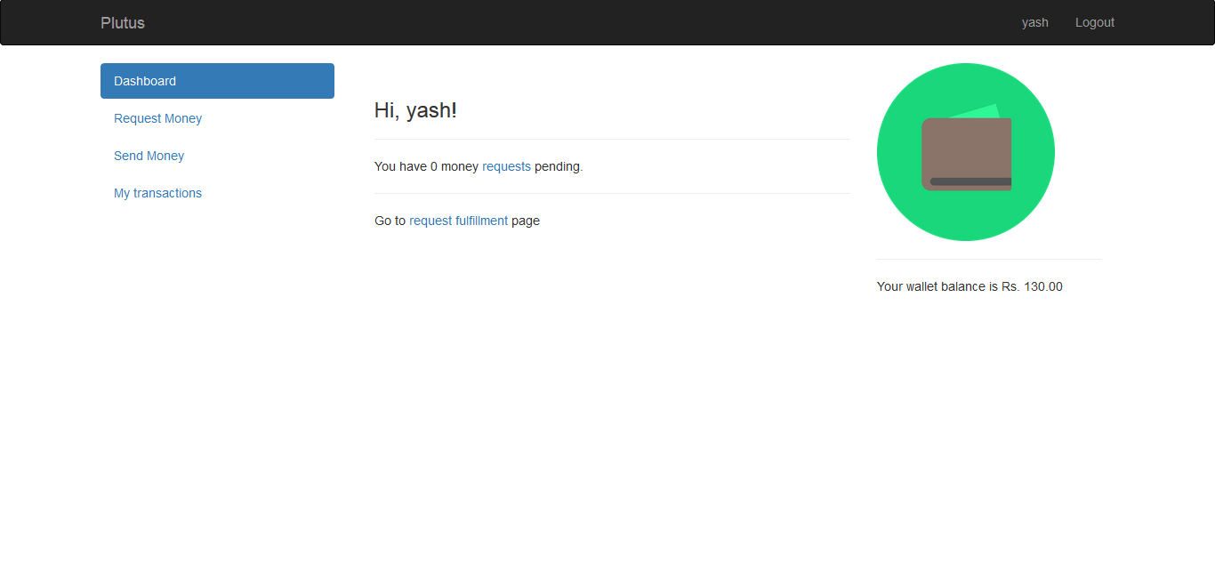
DASHBOARD

Slide 26
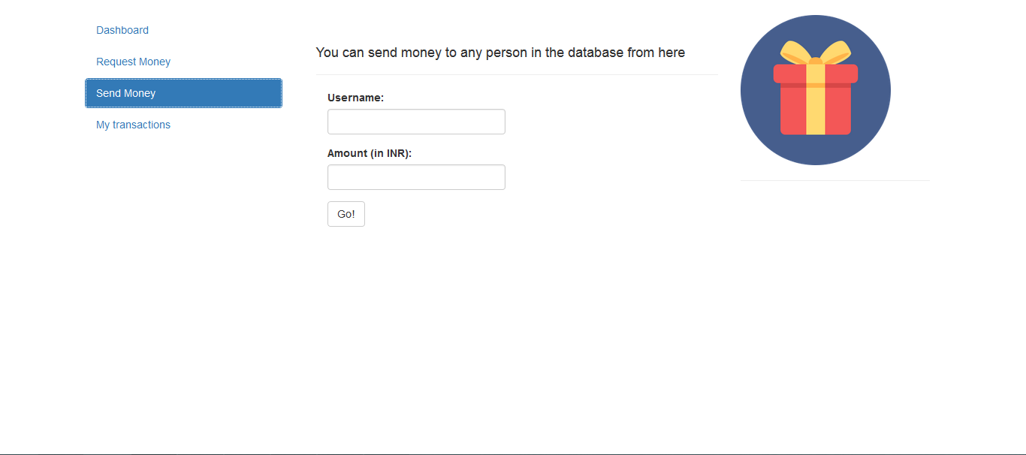
SEND MONEY

Slide 27
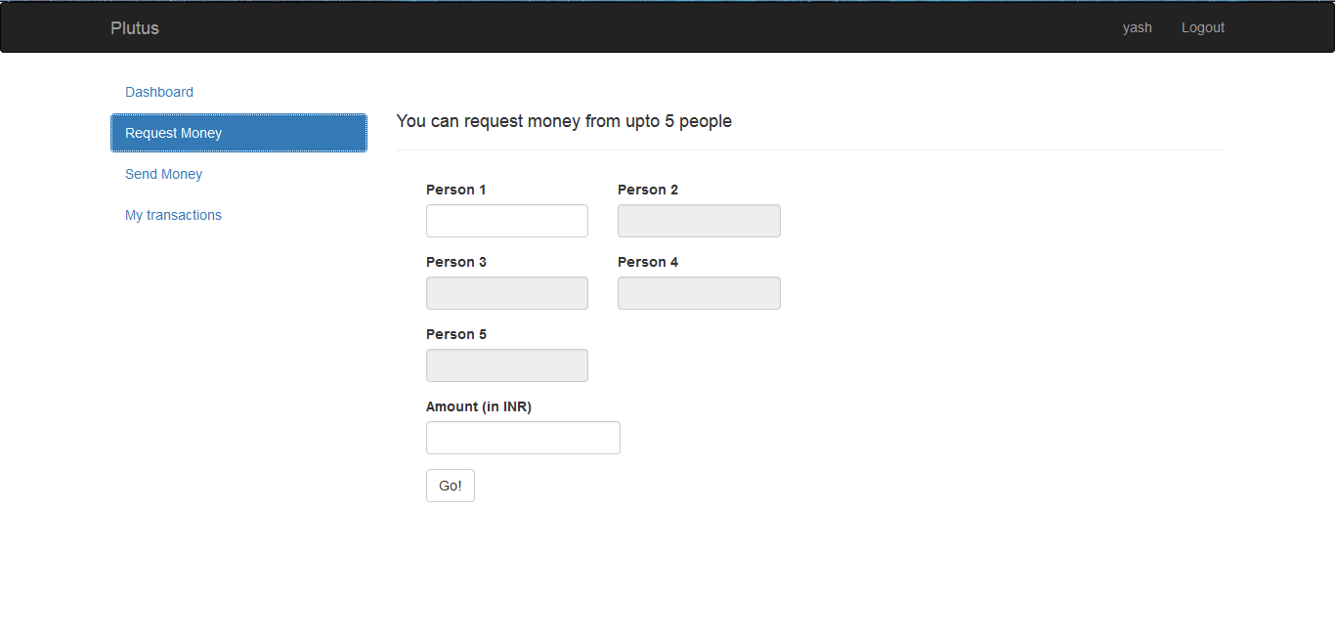
REQUEST

Slide 28
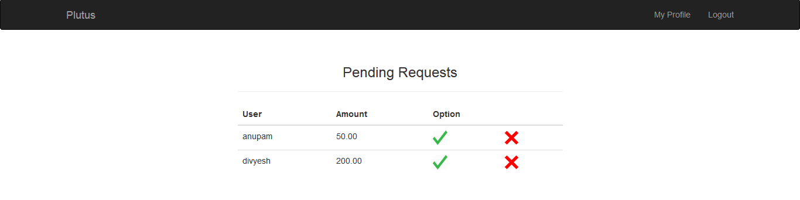
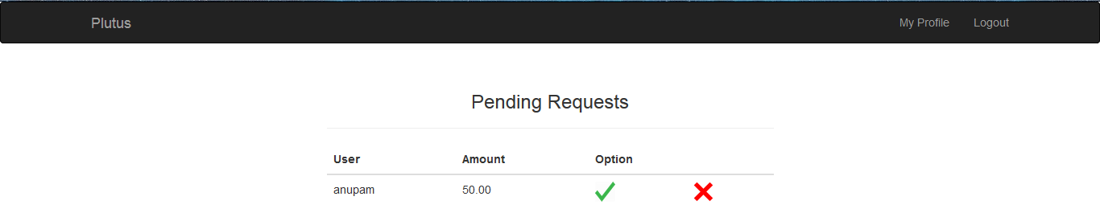
REQUEST FULFILLMENT

Slide 29
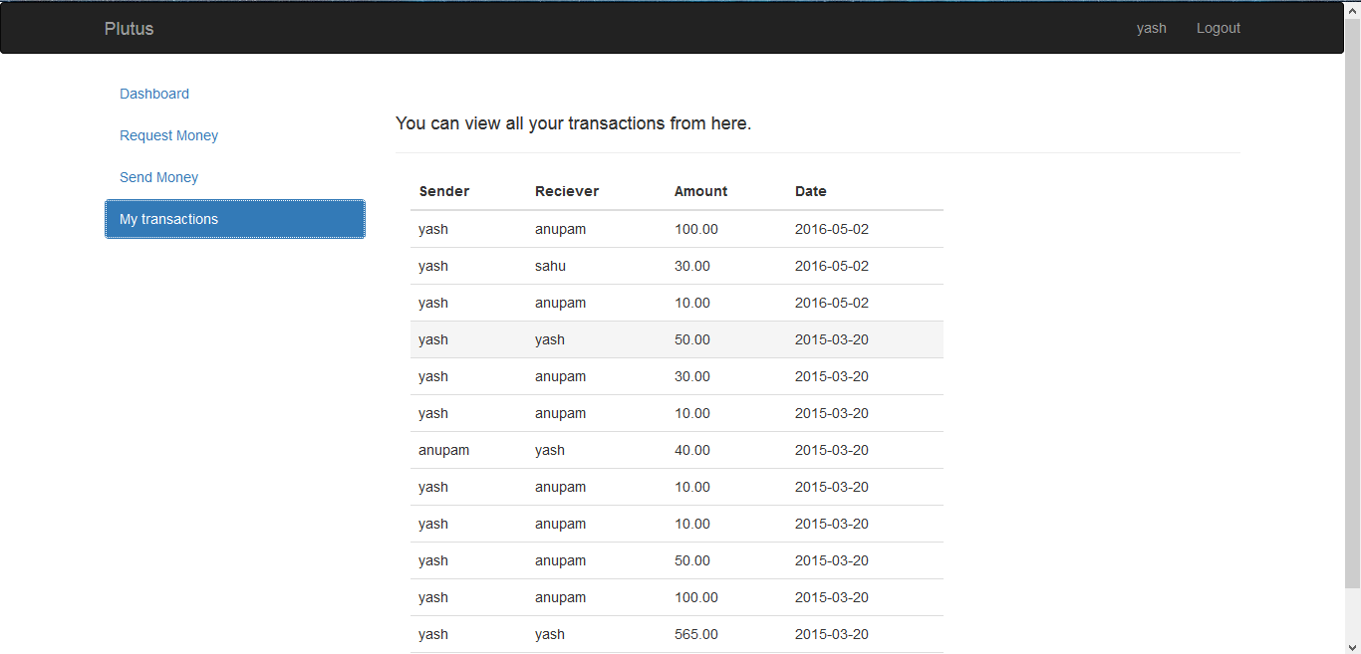
TRANSACTION HISTORY

Slide 30
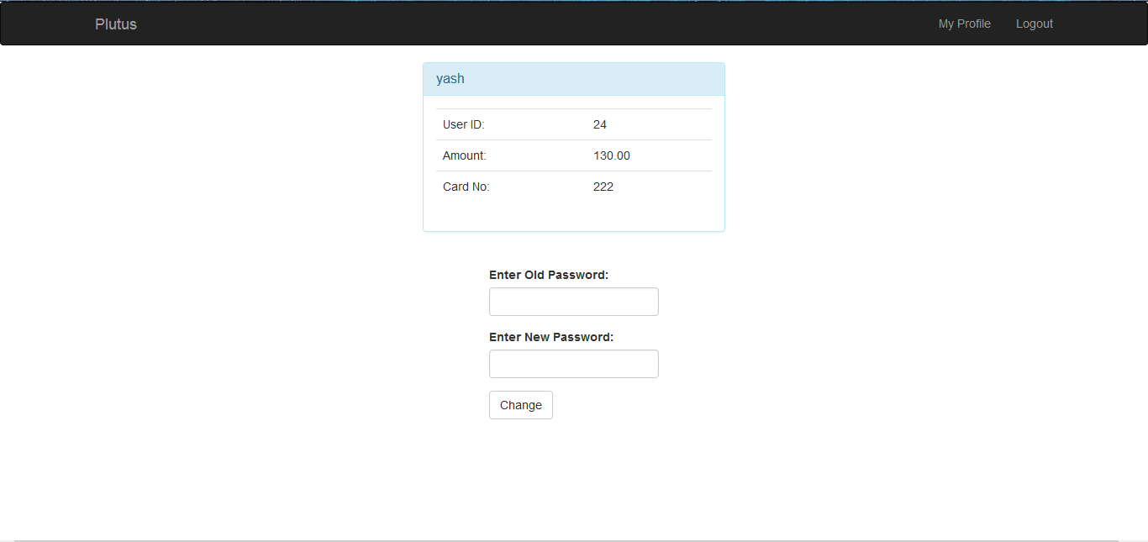
MY PROFILE

Slide 31
TEAM PLUTUS
Anupam Jaiswal IIT2014039
Yash Jain IIT2014043
Lakshay Gupta IIT2014044
Divyesh Soni IIT2014079
Utkarsh Sahu IIT2014080

